Slide 1


Azure Migrate
Sarah Lean
Cloud Solution Architect
Sarah.Lean@Microsoft.com
@TechieLass

Slide 2

Sarah Lean
Cloud Solution Architect
Microsoft
IT Admin since 2005
Blogger
Geek
Glasgow Azure User Group Founder
Photographer
www.techielass.com
@TechieLass

Slide 3

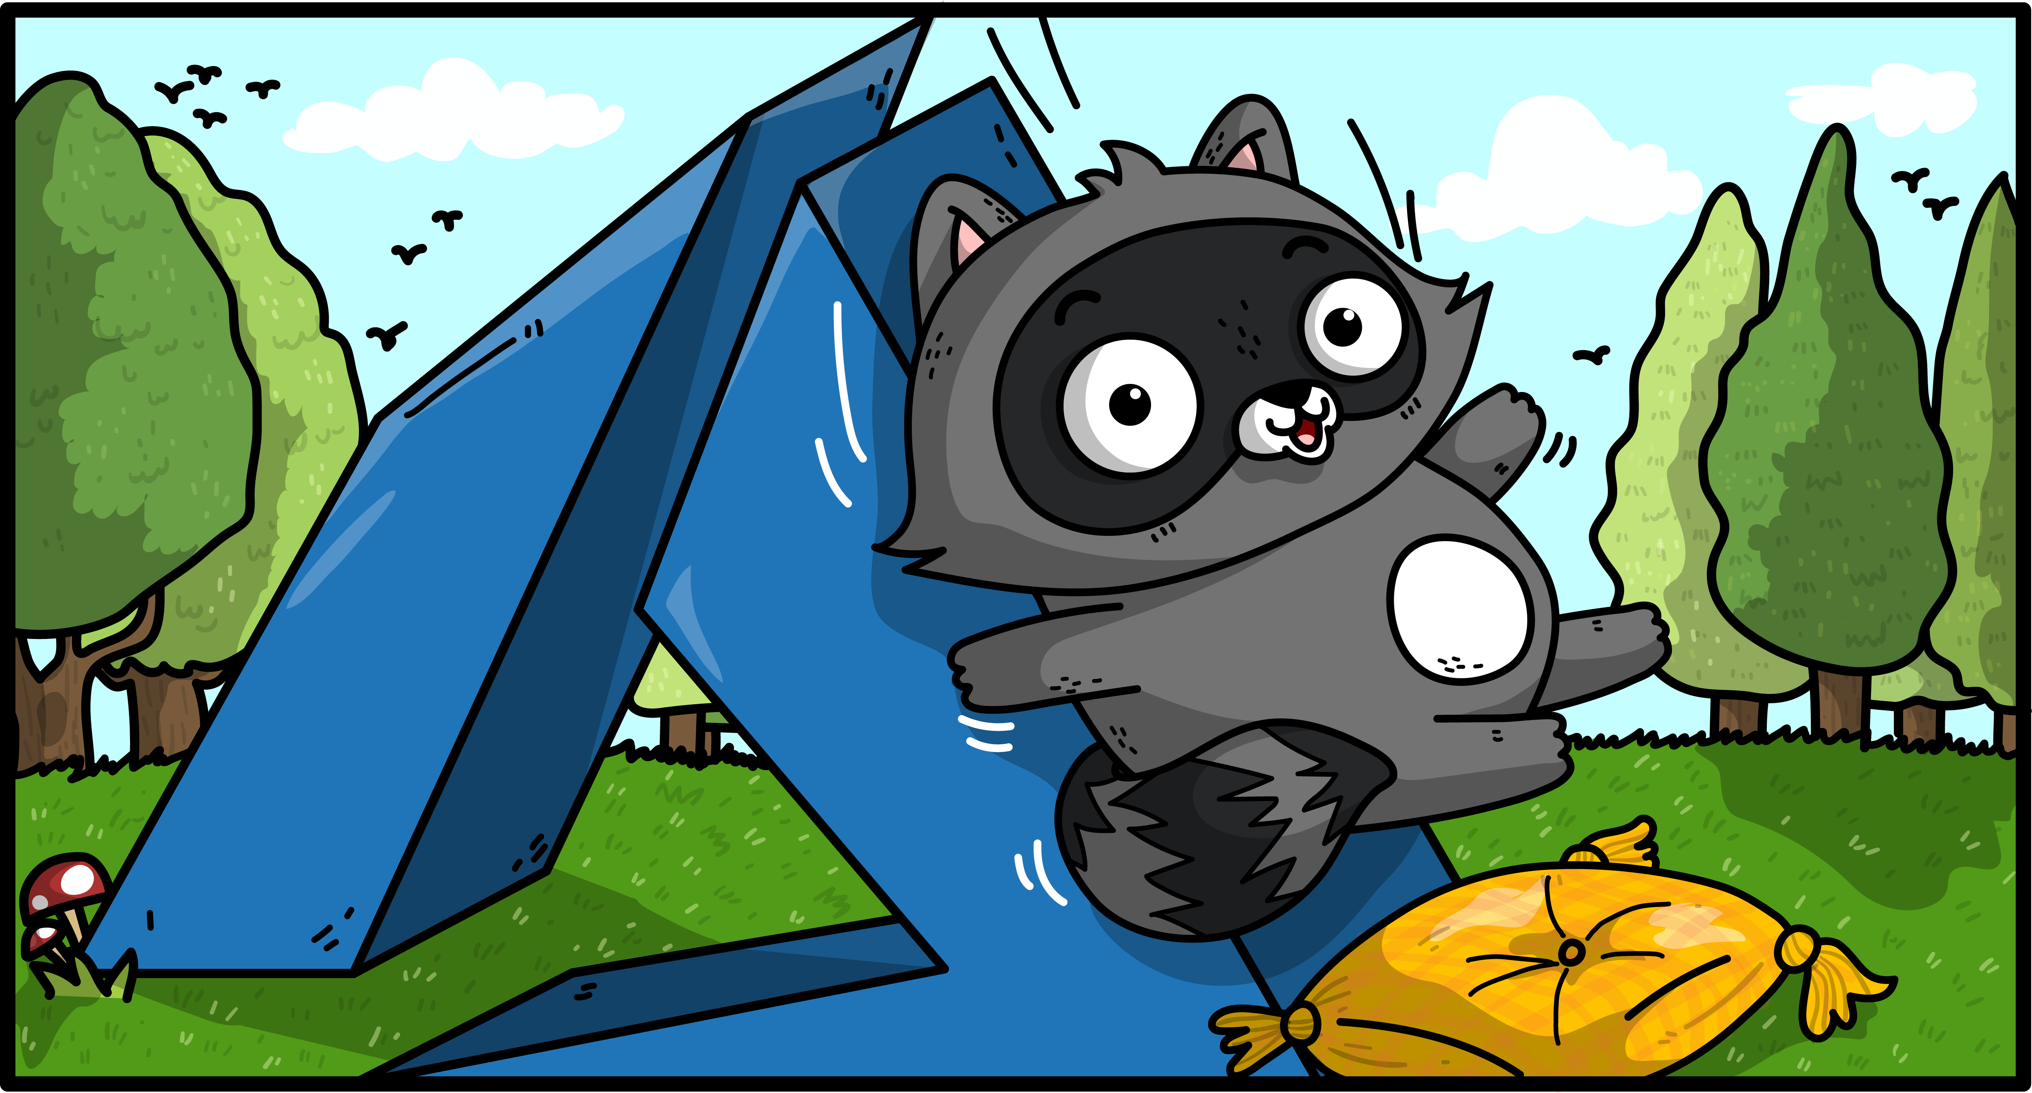
Agenda
Azure Migrate Overview
Practical Advice

Slide 4
What’s Driving Migrations?
Software and hardware refresh
Security threats
Urgent capacity needs
Compliance
Quickly integrate acquisitions
Application innovation
Migration triggers
Software end of support
Datacenter contracts expiry
Notes:
Confluence of migration triggers/catalysts [including outsourced datacenter contract expirations, integrating acquisitions, urgent capacity needs, software & hardware refresh, end of support, security threats (e.g., Spectre), compliance (e.g., GDPR), Need to deliver applications faster]

Slide 5
Azure Migrate
Azure
Windows Server
Linux
Notes:
Azure Migrate is a tool that was released last year. It can help you understand what is going on in your environment, how feasible it is to move your environment to the cloud, costs associated with that and migration risks/paths.
Azure Migrate is a great tool that can be used, free of charge to help you build a business card for a cloud migration.

Slide 6
Explained
Agentless virtual machine discovery through virtual appliance;
Dependency mapping to ensure full visibility of all application VMs;
Intelligent right-sizing;
Cost Analysis;
Azure readiness
Notes:
Azure Migrate is a virtual appliance that can be used to discover what virtual machines in your environment
Dependency mapping can be used to ensure you have fully visibility of all your applications, understand how servers and applications connect and possibly discover unknown dependencies and relationships
Provides intelligent sizing, can help fit the right Azure t-shirt for your on premise VMs.
Detailed cost analysis, helping you to specify region, currency and calculate discounts including Azure Hybrid Benefit for Windows Server
Azure Readiness, a deep assessment of VMs to determine Azure compatibility, suggesting migration recommendations.

Slide 7
Supported Platforms
VMware environment must be managed by a vCenter Server
VMware environments supported 5.5, 6.0, 6.5
Hyper-V and physical server support on the road map
Notes:
Azure Migrate currently only supported VMware, support for 5.5, 6.0 and 6.5
Hyper-v and physical server support coming soon
Azure Migrate projects can be created in West Central US or East US at the moment BUT you can plan migrations to any of the 30 supported target regions

Slide 8
Explained
FREE
Notes:
Azure Migrate is a virtual appliance that can be used to discover what virtual machines in your environment
Dependency mapping can be used to ensure you have fully visibility of all your applications, understand how servers and applications connect and possibly discover unknown dependencies and relationships
Provides intelligent sizing, can help fit the right Azure t-shirt for your on premise VMs.
Detailed cost analysis, helping you to specify region, currency and calculate discounts including Azure Hybrid Benefit for Windows Server
Azure Readiness, a deep assessment of VMs to determine Azure compatibility, suggesting migration recommendations.

Slide 9
Top Tip
Ensure the vCenter Logging level is set at 3 for at least 30 days before you run the Collector tool, this will give you the best recommendations

Slide 10
Demo: Creating a migrate project

Slide 11

Data Collected
Cores
Memory
Disks
Disk Sizes
Network Adapters
CPU usage
Memory usage
Disk IOPS
Disk throughput (MBps)
Network output (MBps)
VM Name
IP Address

Slide 12
Demo:
Create assessment

Slide 13
Understand dependencies
Operations Management Suite Agent
Operations Management Suite Dependency Agent
Notes:
The Microsoft Monitoring Agent service collects events from log files and Windows event log, performance data, and other telemetry. Even when the agent is unable to communicate with the Log Analytics service it reports to, the agent continues to run and queues the collected data on the disk of the monitored computer. When the connection is restored, the Microsoft Monitoring Agent service sends collected data to the service.
Dependency Agent - Service Map shows connections between servers, processes, and ports across any TCP-connected architecture with no configuration required, other than installation of an agent.

Slide 14
Demo:
Service Map

Slide 15
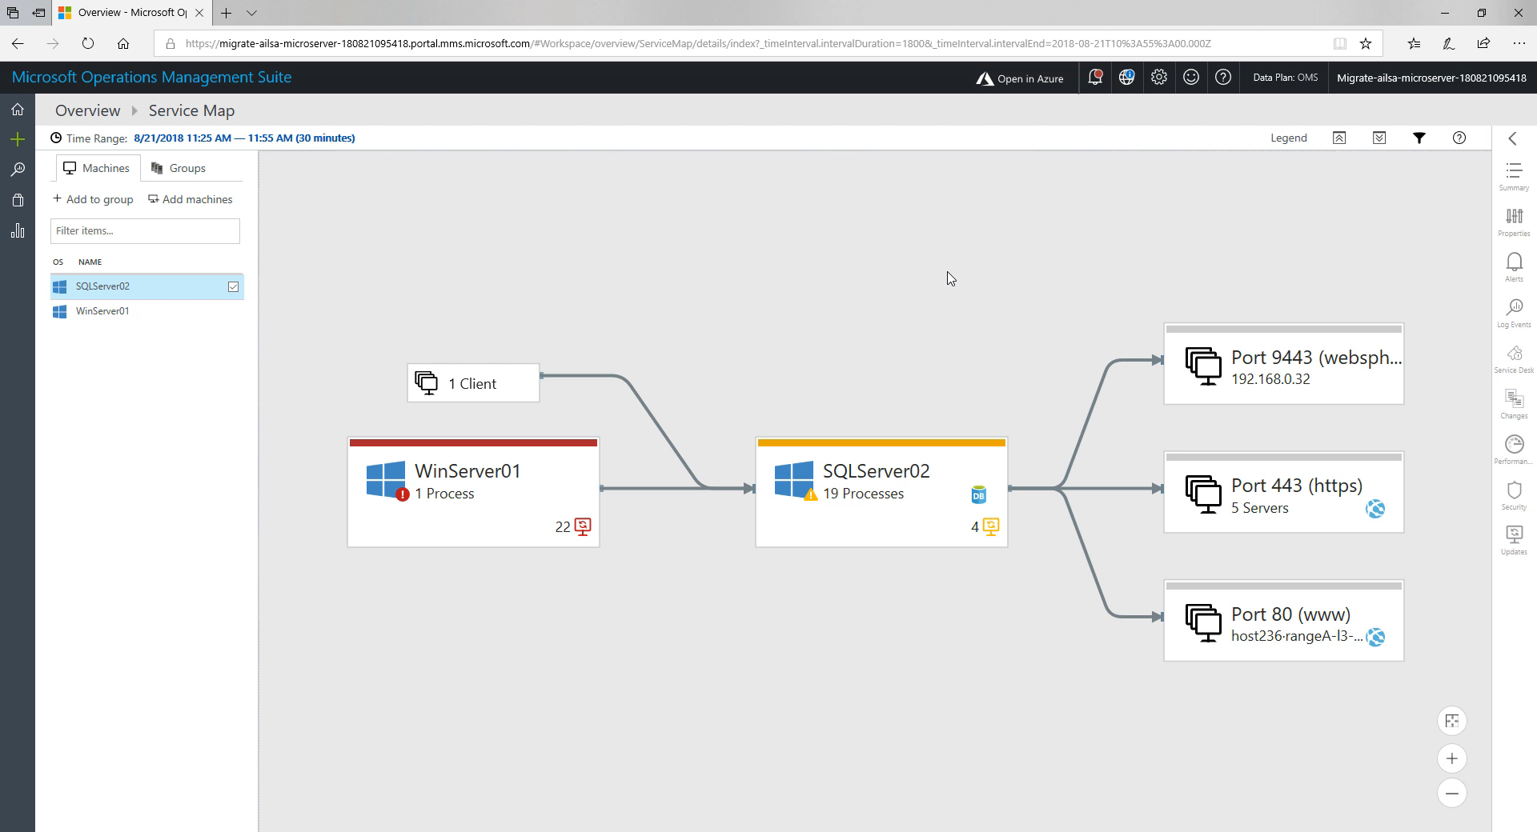

Slide 16
Get ready now to beat EOS deadlines
Avoid business risk
End of support means:
SQL Server 2008 and 2008 R2
Extended Support
Ends July 9, 2019
No security updates
Windows Server 2008 and 2008 R2
Extended Support
Ends January 14, 2020
Compliance concerns
2018
2019
2020
Missed innovation opportunities
Find lifecycle support deadlines at: support.microsoft.com/lifecycle
Notes:
For Windows Server 2008 and Windows Server 2008 R2, end-of-life mainstream support ended January 14, 2015—and Microsoft ends Extended Support on January 14, 2020.
Likewise, Extended Support for SQL Server 2008 and 2008 R2 ends July 9, 2019. The database is often tied to one or more applications running on Windows Server, so it makes sense to look at both as you build your EOS plan.
Many organizations are running workloads on Windows Server 2008 and 2008 R2. You can continue to use Windows Server 2008 R2 safely in your environment’s architecture, at least until the extended support expiration date.
If you put off action, however, you will stop receiving regular security updates, putting your server workloads at risk. We always recommend running current versions of software for the most advanced security, performance and innovation features. Plus, you are always protected with regular security updates. https://portal.msrc.microsoft.com

Slide 17
Windows Server + Azure: Better Together
Best hybrid cloud experience for Windows Server
Hit the cloud running using your Microsoft expertise and familiar tools.
Run SharePoint, SQL Server or any app on Windows Server virtual machines in Azure.
Gain cloud agility with Windows Server containers.
Extend your datacenter to Azure for unique hybrid scenarios with Active Directory, cloud storage, and more.
Get support from a single vendor.
Most cost-effective cloud for Windows Server
Only Azure offers Extended Security Updates for Windows Server 2008 and 2008 R2 for no additional cost
Use existing licenses to save up to 73%* compared to AWS with the Azure Hybrid Benefit and Azure Reserved Instances.
Most powerful security at the OS and cloud levels
Combine the built-in security features of Windows Server 2016 with Azure, the most compliant cloud.
Use Azure Security Center for monitoring and threat protection across on-premises and cloud.
Notes:
When you choose Azure for your Windows Server workloads—you can stay with the technology leader you trust and get unique benefits.

Slide 18
Resources
Azure Migrate Documentation: https://aka.ms/AzureMigrate
Azure Free Tier: https://aka.ms/free
Presentation: https://github.com/weeyin83/Presentations

Slide 19
Q&A

Slide 20
Feedback
https://aka.ms/sarahfeedback

Slide 21
Thanks!
Sarah Lean
Cloud Solution Architect
Sarah.Lean@Microsoft.com
@TechieLass

